Slide 1

TITLE :
FUEL FRAUD PATTERN DETECTION ENGINE
Student Name: A- DEERAJ
Student Id: 2520030113
Cluster: 1
Section: 1
Under The Guidance Of
Supervisor Name: Dr. Rajesh
Assistant Professor
Department of CSE

Slide 2
OUTLINE
1. Abstract
2. Existing System
3. Proposed System
4. System Architecture
5. Project Modules
6. Objectives
7. DSA Data Structures Used
8. CO's Attainments – DSA (CO1...CO5)
9. Screen Shots – DSA Output
10. Conclusion
11. Geo-Tagged Photos

Slide 3
ABSTRACT
FFPDE (Fuel Fraud Pattern Detection Engine) is a fleet monitoring system designed to detect fuel theft in campus transport buses using Java-based Data Structures & Algorithms. The core fraud detection logic is implemented using a priority queue (max-heap), linked list, hash map, queue, quick sort, binary search, and stack-based expression evaluator.
When the fuel mismatch exceeds a threshold of 5 liters, the system detects fraud. Transactions are stored in a linked list, queued for processing via a queue, prioritized by fraud score using a max-heap priority queue, and looked up in O(1) using a HashMap. Amounts are sorted using Quick Sort, and binary search is applied for efficient ID lookup. A stack evaluates fraud-related expressions in postfix notation.

Slide 4
EXISTING SYSTEM
(FUEL FRAUD PATTERN ENGINE)
In the existing fleet management approach, fraud detection relies on manual inspection. Transport supervisors physically compare odometer readings with fuel logs. There is no automated mechanism to cross-verify tank sensor readings with ECU data in real time, and no structured algorithm to detect patterns of repeated theft.
From a DSA perspective, the absence of priority-based detection means high-risk transactions are never surfaced first. Without hash-based lookups, transaction retrieval is O(n). Without sorted data, searching for specific transactions is slow. No structured queue processes transactions in order, and no algorithmic threshold-check automates fraud classification.

Slide 5
PROPOSED SYSTEM
The proposed FFPDE system introduces an automated, algorithm-driven fuel fraud detection system implemented entirely in Java using core DSA concepts. Transactions are chained in a Linked List for sequential traversal, added to a Queue for FIFO processing, and ranked by fraud score using a Max-Heap Priority Queue.
A HashMap provides O(1) transaction lookups by ID. Quick Sort arranges transactions by amount for efficient analysis. Binary Search enables fast ID-based retrieval on sorted data. A Stack evaluates postfix fraud expressions. Together these structures form a complete, real-world DSA implementation that detects fraud, prioritizes alerts, and demonstrates algorithm efficiency.

Slide 6
SYSTEM ARCHITECTURE
1. Input Layer
Transaction data (ID, User, Amount, FraudScore) → stored in Linked List
2. Processing Layer (Queue + Heap)
Queue for FIFO transaction processing → Max-Heap for priority fraud detection
3. Lookup Layer (HashMap)
O(1) transaction retrieval by ID using Java HashMap
4. Analysis Layer (Sort + Search)
Quick Sort by Amount → Binary Search for fast ID lookup

Slide 7
PROJECT MODULES
1. Linked List Module
TransactionList: stores all transactions as a singly linked list. Supports sequential add and display.
2. Queue Module
TransactionQueue: FIFO processing of transactions using Java's LinkedList-backed Queue interface.
3. Priority Queue / Heap Module
FraudDetector: max-heap ranks transactions by fraudScore. Highest-risk transaction surfaced first via poll().
4. HashMap Module
TransactionHash: O(1) insert and search by transaction ID using Java HashMap.
5. Sorting & Searching Module
Quick Sort by amount; Binary Search by ID on sorted array for efficient retrieval.
6. Stack / Expression Module
Expression: stack-based postfix expression evaluator demonstrating stack operations.

Slide 8
OBJECTIVES
The main objective is to implement a real-world fraud detection system using core Java DSA concepts — Linked List, Queue, Priority Queue (Max-Heap), HashMap, Quick Sort, Binary Search, and Stack — applied to a practical fleet fuel monitoring problem.
Secondary objectives include demonstrating time complexity trade-offs (O(1) HashMap vs O(n) list search), validating priority-based fraud alerting using a max-heap, and implementing in-place sorting with Quick Sort. The system also demonstrates stack-based expression evaluation and binary search efficiency on sorted datasets. Future objectives include IoT integration and route-based fuel profiling.

Slide 9
DSA DATA STRUCTURES USED
Data Structure
Usage in FFPDE
Linked List
Store all transactions sequentially; O(n) traversal
Queue (FIFO)
Process transactions in arrival order
Priority Queue / Max-Heap
Surface highest fraudScore transaction first; O(log n) insert
HashMap
O(1) lookup, insert, and search by transaction ID
Quick Sort
Sort transactions by amount; O(n log n) average
Binary Search
Find transaction by ID after sorting; O(log n)
Stack
Postfix expression evaluation for fraud scoring formulas

Slide 10
CO'S ATTAINMENTS – DSA
CO1: Understand and implement core data structures — Linked List, Queue, Priority Queue, HashMap, Stack — to manage and process fuel transactions in Java.
CO2: Apply sorting (Quick Sort) and searching (Binary Search) algorithms to efficiently organize and retrieve transaction records by amount and ID.
CO3: Demonstrate the use of a Max-Heap Priority Queue to prioritize high-risk fraud transactions and surface the highest fraudScore first.
CO4: Design a multi-module Java program that integrates all DSA components into a cohesive, real-world fuel fraud detection system with clear algorithmic flow.
CO5: Implement and validate the complete Java DSA program with sample transaction data, verifying correct output for fraud detection, sorting, searching, and expression evaluation.

Slide 11
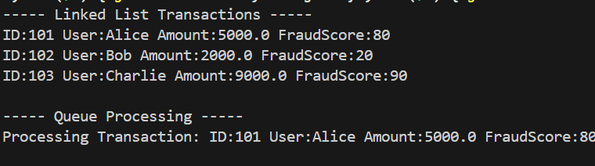
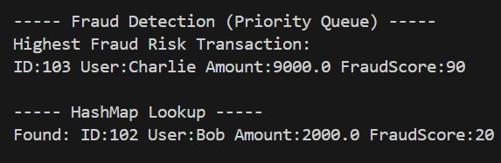
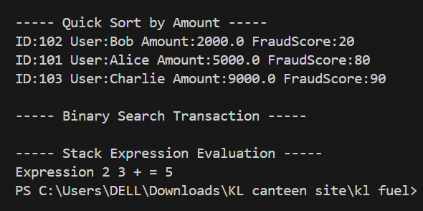
SCREEN SHOTS – DSA OUTPUT
[Add Screenshot Here]
[Add Screenshot Here]
[Add Screenshot Here]
Linked List & Queue Output
Priority Queue & HashMap Output
Sort, Search & Stack Output

Slide 12
CONCLUSION
The FFPE (Fuel Fraud Pattern Engine) DSA project successfully demonstrates how classical data structures and algorithms can be applied to a practical real-world problem. By implementing a Linked List, Queue, Max-Heap Priority Queue, HashMap, Quick Sort, Binary Search, and Stack in Java, the system achieves efficient transaction storage, processing, retrieval, and fraud prioritization.
The project validates that algorithm selection directly impacts performance — O(1) HashMap lookups outperform O(n) linear search, and O(n log n) Quick Sort enables Binary Search efficiency. The max-heap ensures the highest-risk transaction is always surfaced first. Together, these components form a structured, complete DSA implementation that effectively demonstrates algorithmic thinking applied to fleet transport fraud detection.

Slide 13
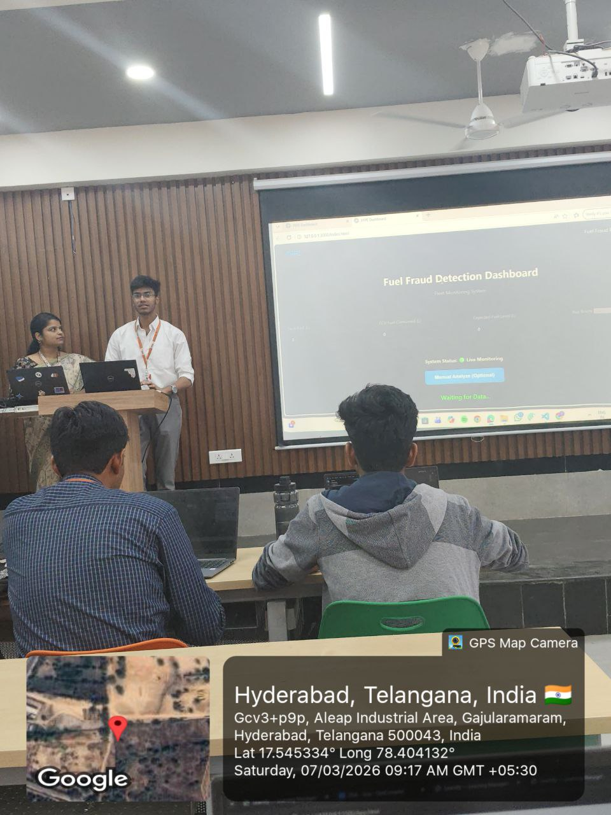
GEO-TAG
[Add Geo-Tagged Photo Here]

Slide 14
THANK YOU

